Slide 1
Chapter 6: Formal Relational Query Languages

Slide 2
Formal Relational Query Languages
Relational Algebra
Tuple Relational Calculus
Domain Relational Calculus

Slide 3
Relational Algebra
Six fundamental operations:
select: σ
project: ∏
union: ∪
set difference: –
Cartesian product: x
rename: ρ
The operators take one or two relations as inputs and produce a new relation as a result.
Unary, Binary operations

Slide 4
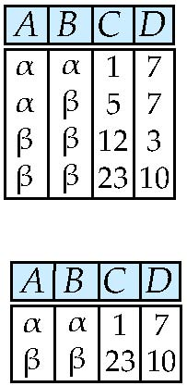
Select Operation – Example
Relation r
σ_{A=B ^ D > 5} (r)

Slide 5
Select Operation
Notation: σ _{p}(r)
p is called the selection predicate Defined as: σ_{p}(r) = {t | t ∈ r and p(t)}
Where p is a formula in propositional calculus consisting of terms connected by : ∧ (and), ∨ (or), ¬ (not) Each term is one of:
<attribute> op <attribute> or <constant>
where op is one of: =, ≠, >, ≥. <. ≤ Example of selection: σ _{dept_name=“Physics”}(instructor)

Slide 6
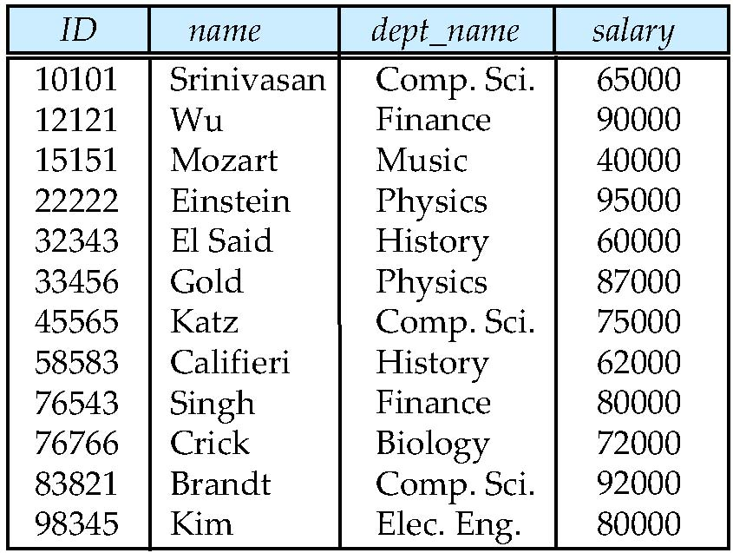
Instructor -Relation
Find tuples of the instructor relation where the instructor is in the “Physics” department:
find all instructors with salary greater than $90,000
find the instructors in Physics with a salary greater than $90,000

Slide 7

Select…

Slide 8

comparisons between two attributes.
To find all departments whose name is the same as their building name

Slide 9
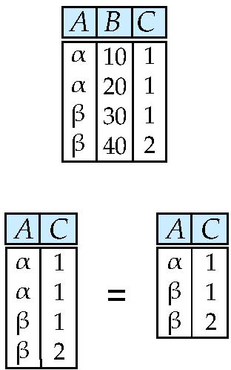
Project Operation – Example
Relation r:
∏_{A,C} (r)

Slide 10
Project Operation
Notation:
where A₁, A₂ are attribute names and r is a relation name.
The result is defined as the relation of k columns obtained by erasing the columns that are not listed
Duplicate rows removed from result, since relations are sets
Example: To eliminate the dept_name attribute of instructor ∏_{ID, name, salary} (instructor)

Slide 11
Composition of Relational Operations
result of a relational operation is itself a relation is important.
Consider the more complicated query
“Find the name of all instructors in the Physics department.” We write:
instead of giving the name of a relation as the argument of the projection operation, we give an expression that evaluates to a relation.
In general, since the result of a relational-algebra operation is of the same type (relation) as its inputs, relational-algebra operations can be composed together into a relational-algebra expression

Slide 12
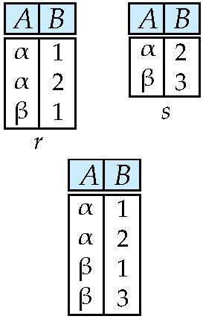
Union Operation – Example
Relations r, s:
r ∪ s:

Slide 13
Union Operation
Notation: r ∪ s
Defined as:
r ∪ s = {t | t ∈ r or t ∈ s}
For r ∪ s to be valid:
1. r, s must have the same arity (same number of attributes)
2. The attribute domains must be compatible (example: 2nd column of r deals with the same type of values as does the 2nd column of s)

Slide 14
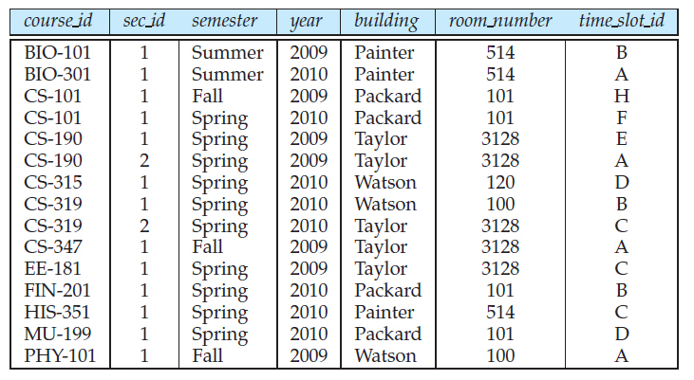
Section-Relation

Slide 15
Example: to find all courses taught in the Fall 2009 semester, or in the Spring 2010 semester, or in both ∏_{course_id} (σ _{semester=“Fall” Λ year=2009} (section)) ∪ ∏_{course_id} (σ _{semester=“Spring” Λ year=2010} (section))

Slide 16
Answer…

Slide 17
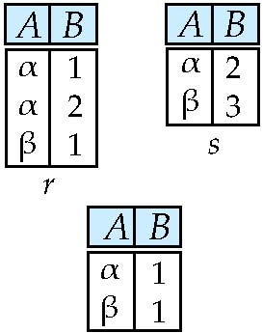
Set difference of two relations
Relations r, s:
r – s:

Slide 18
Set Difference Operation
Notation r – s
Defined as:
r – s = {t | t ∈ r and t ∉ s}
Set differences must be taken between compatible relations.
r and s must have the same arity
attribute domains of r and s must be compatible

Slide 19
Example: to find all courses taught in the Fall 2009 semester, but not in the Spring 2010 semester ∏_{course_id} (σ _{semester=“Fall” Λ year=2009} (section)) − ∏_{course_id} (σ _{semester=“Spring” Λ year=2010} (section))

Slide 21
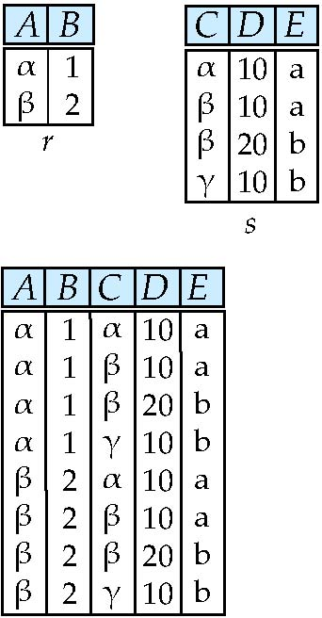
Cartesian-Product Operation – Example
Relations r, s:
r x s:

Slide 22
Cartesian-Product Operation
Notation r x s
Defined as:
r x s = {t q | t ∈ r and q ∈ s}
same attribute name may appear in both r1 and r2,
For example, the relation schema for r = instructor × teaches is:
(instructor.ID, instructor.name, instructor.dept name, instructor.salary teaches.ID, teaches.course id, teaches.sec id, teaches.semester, teaches.year)
For those attributes that appear in only one of the two schemas, we shall usually drop the relation-name prefix. We can then write the relation schema for r as:
(instructor.ID, name, dept name, salary teaches.ID, course id, sec id, semester, year)

Slide 23
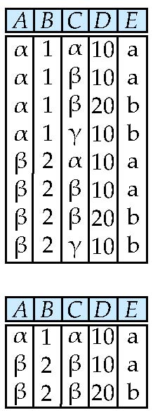
Composition of Operations
Can build expressions using multiple operations
Example: σ_{A=C}(r x s)
r x s
σ_{A=C}(r x s)

Slide 24
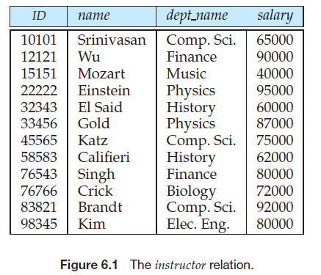
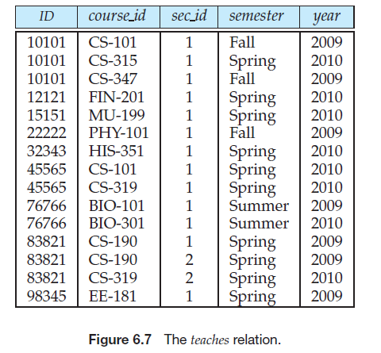

Slide 25
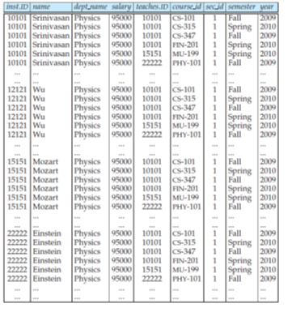

Slide 26
Cartesian-Product…
In general, if we have relations r1(R1) and r2(R2), then r1 × r2 is a relation whose schema is the concatenation of R1 and R2.
Relation R contains all tuples t for which there is a tuple t1 in r1 and a tuple t2 in r2 for which t[R1] = t1[R1] and t[R2] = t2[R2].
find the names of all instructors in the Physics department together with the course id of all courses they taught.
We need the information in both the instructor relation and the teaches relation to do so. If we write:

Slide 27
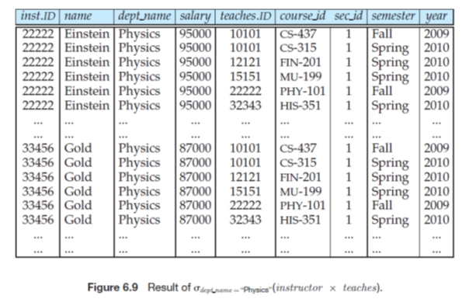

Slide 28
tuple in dept name =“Physics”(instructor × teaches) that contains his name, and which satisfies instructor.ID = teaches.ID. So, if we write:
we get only those tuples of instructor × teaches that pertain to instructors in Physics and the courses that they taught.
Finally, since we only want the names of all instructors in the Physics department together with the course id of all courses they taught, we do a projection:

Slide 29
Practice Question
Find the titles of courses in the Comp. Sci. department that have 3 credits.

Slide 30
Rename Operation
Allows us to name, therefore to refer to results of relational-algebra expressions.
Allows us to refer to a relation by more than one name.
Example:
ρ _{x} (E) returns the expression E under the name X
If a relational-algebra expression E has arity n, then
returns the result of expression E under the name X, and with the attributes renamed to A₁ , A₂ , …., A_{n} .

Slide 31
Example Query
Find the largest salary in the university
Step 1: find instructor salaries that are less than some other instructor salary (i.e. not maximum)
using a copy of instructor under a new name d
∏_{instructor.salary} (σ _{instructor.salary < d,salary} (instructor x ρ_{d} (instructor)))
Step 2: Find the largest salary
∏_{salary} (instructor) – ∏_{instructor.salary} (σ _{instructor.salary < d,salary} (instructor x ρ_{d} (instructor)))

Slide 32
Formal Definition
A basic expression in the relational algebra consists of either one of the following:
A relation in the database
A constant relation
Let E₁ and E₂ be relational-algebra expressions; the following are all relational-algebra expressions:
E₁ ∪ E₂
E₁ – E₂
E₁ x E₂
σ_{p} (E₁), P is a predicate on attributes in E₁
∏_{s}(E₁), S is a list consisting of some of the attributes in E₁
ρ _{x} (E₁), x is the new name for the result of E₁

Slide 33
Additional Operations
We define additional operations that do not add any power to the relational algebra, but that simplify common queries.
Set intersection
Natural join
Assignment
Outer join

Slide 34
Set-Intersection Operation
Notation: r ∩ s
Defined as:
r ∩ s = { t | t ∈ r and t ∈ s }
Assume:
r, s have the same arity
attributes of r and s are compatible
Note: r ∩ s = r – (r – s)

Slide 35
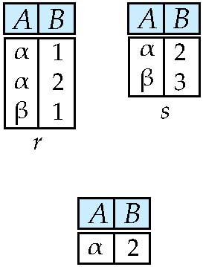
Set-Intersection Operation – Example
Relation r, s:
r ∩ s

Slide 36
Natural-Join Operation
Notation: r s
Let r and s be relations on schemas R and S respectively. Then, r s is a relation on schema R ∪ S obtained as follows:
Consider each pair of tuples t_{r} from r and t_{s} from s.
If t_{r} and t_{s} have the same value on each of the attributes in R ∩ S, add a tuple t to the result, where
t has the same value as t_{r} on r
t has the same value as t_{s} on s
Example:
R = (A, B, C, D)
S = (E, B, D)
Result schema = (A, B, C, D, E)
r s is defined as: ∏_{r.A, r.B, r.C, r.D, s.E} (σ_{r.B = s.B ∧ r.D = s.D} (r x s))

Slide 37
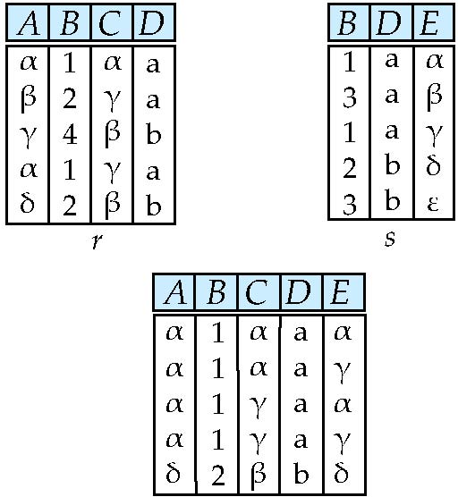
Natural Join Example
Relations r, s:
r s

Slide 38
Notation
Formal definition of the natural join:
Consider two relations r (R) and s(S). The natural join of r and s, denoted by r s, is a relation on schema R ∪ S formally defined as follows:
r s = R ∪ S (r.A1 =s.A1 ∧r.A2 =s.A2 ∧...∧r.An =s.An (r × s))
where R ∩ S = {A1, A2, . . . , An}.
Please note that if r (R) and s(S) are relations without any attributes in common, that is, R ∩ S = ∅, then r s = r × s.

Slide 40
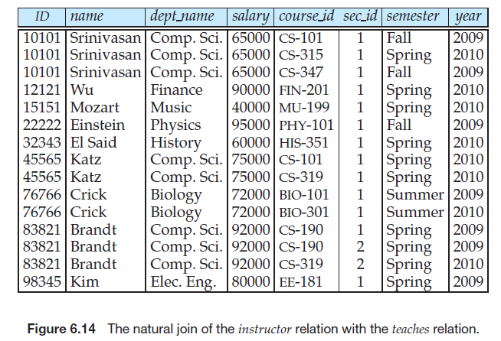

Slide 41
Natural Join and Theta Join
Find the names of all instructors in the Comp. Sci. department together with the course titles of all the courses that the instructors teach
∏ _{name, title} (σ _{dept_name=“Comp. Sci.”} (instructor teaches course))
Natural join is associative
(instructor teaches) course is equivalent to instructor (teaches course)
Natural join is commutative
instruct teaches is equivalent to teaches instructor
The theta join operation is defined as – variant of Natural Join to combine Cartesian product and Selection condition.
r _{θ} s = σ_{θ} (r x s)

Slide 42

Theta Join
Boat
Car
CarModel | CarPrice
CarA | 20,000
CarB | 30,000
CarC | 50,000
BoatModel | BoatPrice
Boat1 | 10,000
Boat2 | 40,000
Boat3 | 60,000
CarModel | CarPrice | BoatModel | BoatPrice
CarA | 20,000 | Boat1 | 10,000
CarB | 30,000 | Boat1 | 10,000
CarC | 50,000 | Boat1 | 10,000
CarC | 50,000 | Boat2 | 40,000

Slide 43
Assignment Operation
The assignment operation (←) provides a convenient way to express complex queries.
Write query as a sequential program consisting of a series of assignments
followed by an expression whose value is displayed as a result of the query.
Assignment must always be made to a temporary relation variable.

Slide 44
Assignment …
The natural join of r and s, denoted by r s, is a relation
on schema R ∪ S formally defined as follows:
r s = R ∪ S (r.A1 =s.A1 ∧r.A2 =s.A2 ∧...∧r.An =s.An (r × s))
We could write r s as:
temp1 ← R × S
temp2 ← r.A1 =s.A1 ∧r.A2 =s.A2 ∧...∧r.An =s.An (temp1)
result = R ∪ S (temp2)

Slide 45
Outer Join
An extension of the join operation that avoids loss of information.
Computes the join and then adds tuples form one relation that does not match tuples in the other relation to the result of the join.
Uses null values:
null signifies that the value is unknown or does not exist
All comparisons involving null are (roughly speaking) false by definition.
We shall study precise meaning of comparisons with nulls later

Slide 46
Outer Join – Example
Relation instructor1
ID
name
dept_name
10101
12121
15151
Srinivasan
Wu
Mozart
Comp. Sci.
Finance
Music
Relation teaches1
ID
course_id
10101
12121
76766
CS-101
FIN-201
BIO-101

Slide 47
Outer Join – Example
Join instructor teaches
ID
name
dept_name
course_id
10101
12121
Srinivasan
Wu
Comp. Sci.
Finance
CS-101
FIN-201
Left Outer Join
instructor teaches
ID
name
dept_name
course_id
10101
12121
15151
Srinivasan
Wu
Mozart
Comp. Sci.
Finance
Music
CS-101
FIN-201
null

Slide 48
Outer Join – Example
Right Outer Join
instructor teaches
ID
name
dept_name
course_id
10101
12121
76766
Srinivasan
Wu
null
Comp. Sci.
Finance
null
CS-101
FIN-201
BIO-101
Full Outer Join
instructor teaches
ID
name
dept_name
course_id
10101
12121
15151
76766
Srinivasan
Wu
Mozart
null
Comp. Sci.
Finance
Music
null
CS-101
FIN-201
null
BIO-101

Slide 49
Null Values
It is possible for tuples to have a null value, denoted by null, for some of their attributes
null signifies an unknown value or that a value does not exist.
The result of any arithmetic expression involving null is null.
Aggregate functions simply ignore null values (as in SQL)
For duplicate elimination and grouping, null is treated like any other value, and two nulls are assumed to be the same (as in SQL)

Slide 50
Null Values
Comparisons with null values return the special truth value: unknown
If false was used instead of unknown, then not (A < 5) would not be equivalent to A >= 5
Three-valued logic using the truth value unknown:
OR: (unknown or true) = true, (unknown or false) = unknown (unknown or unknown) = unknown
AND: (true and unknown) = unknown, (false and unknown) = false, (unknown and unknown) = unknown
NOT: (not unknown) = unknown
In SQL “P is unknown” evaluates to true if predicate P evaluates to unknown
Result of select predicate is treated as false if it evaluates to unknown

Slide 51
Extended Relational-Algebra-Operations
Generalized Projection
Aggregate Functions

Slide 52
Generalized Projection
Extends the projection operation by allowing arithmetic functions to be used in the projection list.
E is any relational-algebra expression
Each of F₁, F₂, …, F_{n} are are arithmetic expressions involving constants and attributes in the schema of E.
Given relation instructor(ID, name, dept_name, salary) where salary is annual salary, get the same information but with monthly salary
∏_{ID, name, dept_name, salary/12} (instructor)

Slide 53

Aggregate Functions and Operations
Aggregation function takes a collection of values and returns a single value as a result.
avg: average value min: minimum value max: maximum value sum: sum of values count: number of values
Aggregate operation in relational algebra
E is any relational-algebra expression
G₁, G₂ …, G_{n} is a list of attributes on which to group (can be empty)
Each F_{i} is an aggregate function
Each A_{i} is an attribute name
Note: Some books/articles use γ instead of (Calligraphic G)

Slide 54
Aggregate Operation – Example
A
B
C
Relation r:
α
α
β
β
α
β
β
β
7
7
3
10
_{sum(c)} (r)
sum(c )
27

Slide 55
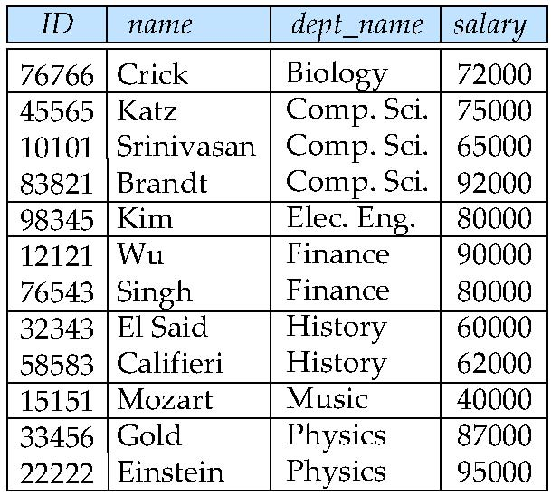
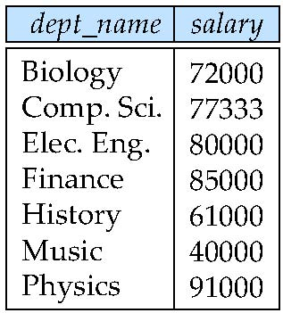
Aggregate Operation – Example
Find the average salary in each department
_{dept_name} _{avg(salary)} (instructor)
avg_salary

Slide 56
Aggregate Functions (Cont.)
Result of aggregation does not have a name
Can use rename operation to give it a name
For convenience, we permit renaming as part of aggregate operation
_{dept_name} _{avg(salary) as avg_sal} (instructor)

Slide 57
Multiset Relational Algebra
Pure relational algebra removes all duplicates
e.g. after projection
Multiset relational algebra retains duplicates, to match SQL semantics
SQL duplicate retention was initially for efficiency, but is now a feature
Multiset relational algebra defined as follows
selection: has as many duplicates of a tuple as in the input, if the tuple satisfies the selection
projection: one tuple per input tuple, even if it is a duplicate
cross product: If there are m copies of t1 in r, and n copies of t2 in s, there are m x n copies of t1.t2 in r x s

Slide 58
SQL and Relational Algebra
select A1, A2, .. An from r1, r2, …, rm where P
is equivalent to the following expression in multiset relational algebra
∏ _{A1, .., An} (σ _{P} (r1 x r2 x .. x rm))
select A1, A2, sum(A3) from r1, r2, …, rm where P group by A1, A2
is equivalent to the following expression in multiset relational algebra
_{A1, A2} _{sum(A3)} ∏ _{A1, A2} (σ _{P} (r1 x r2 x .. x rm)))

Slide 59
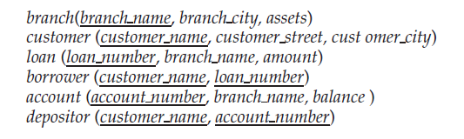
Banking Database

Slide 60
Example Queries
Find the names of all customers who have a loan and an account at bank.
Find the name of all customers who have a loan at the bank and the loan amount

Slide 61
Answers..
∏_{customer_name} (borrower) ∩ ∏_{customer_name} (depositor)
∏customer_name, loan_number, amount (borrower loan)

Slide 62
End of Chapter 6

